Slide 1


Building An Aircraft
Godala Sukumar Reddy(2020BTechcse032)

Slide 2
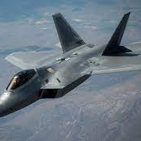
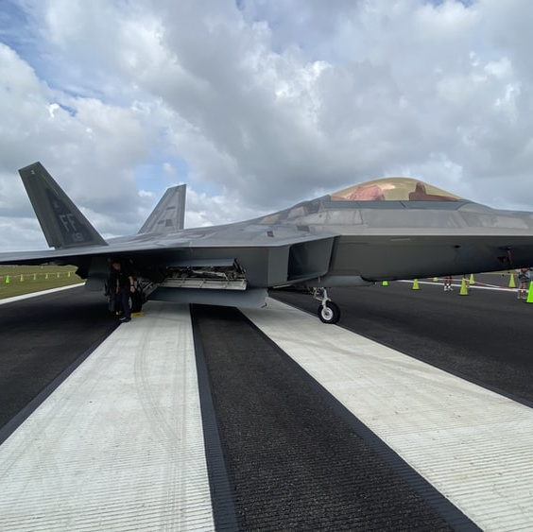
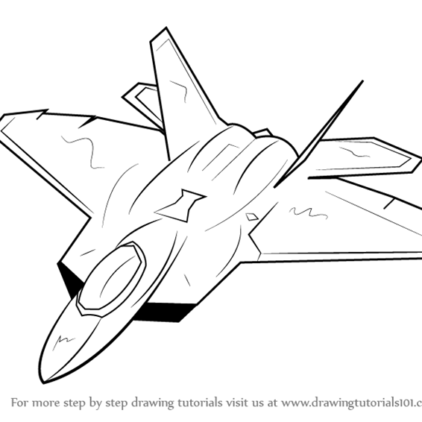
Agenda
To Build and Aircraft
Aerodynamics
Light Weight
Efficiency
Stability

Slide 3
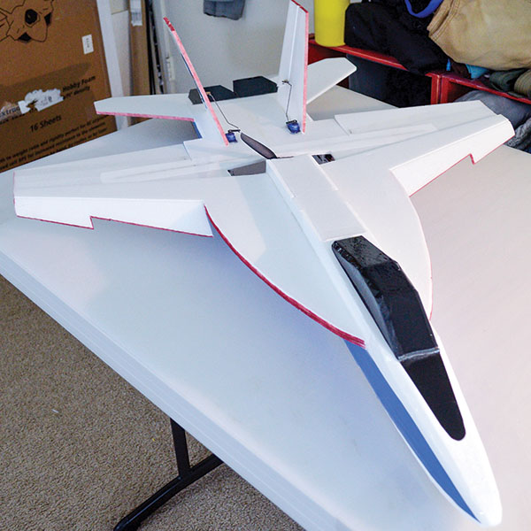
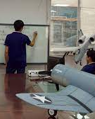

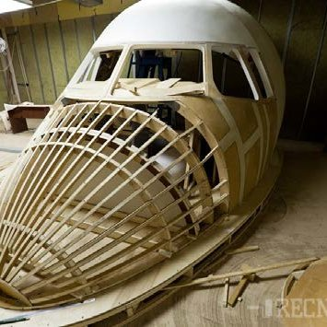
Introduction
A fixed-wing aircraft propelled forward by propulsion from a jet engine, propeller, or rocket engine is known as aeroplane . There are many different sizes, forms, and wing arrangements for aircraft.

Slide 4
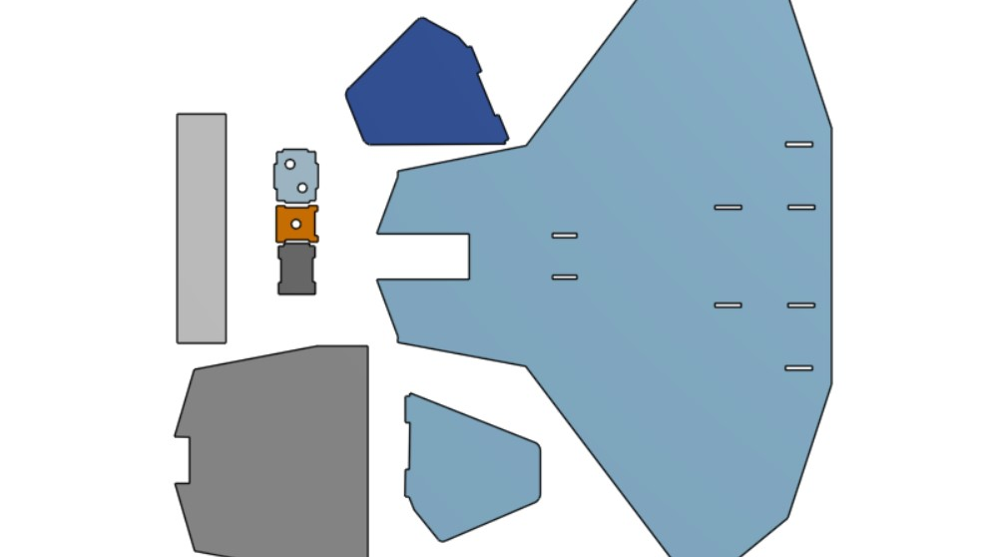
Structure Design in Onshape
Onshape is the only Software-as-a-Service (SaaS) product development platform that combines CAD, built-in PDM, real-time collaboration tools,

Slide 5
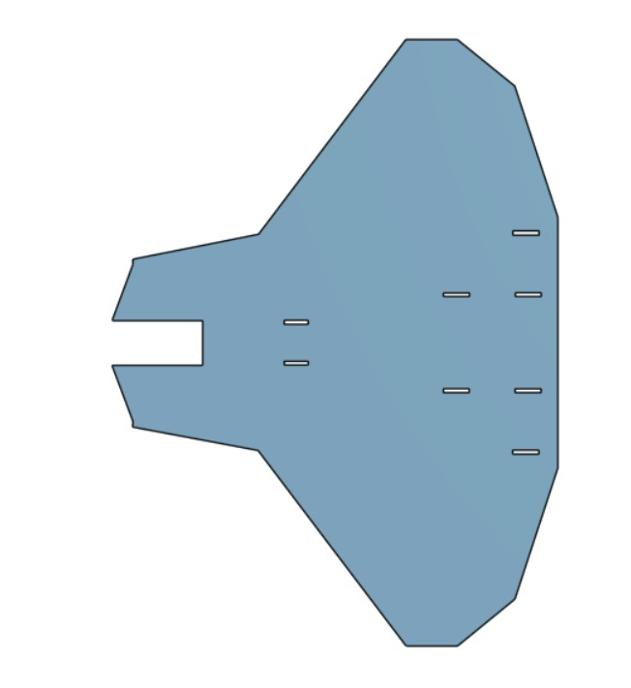
Onshape Models

Slide 6
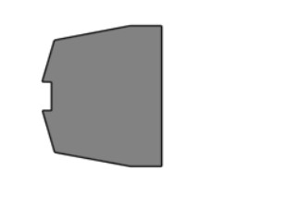
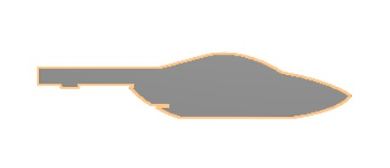
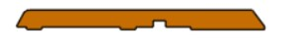

Slide 7
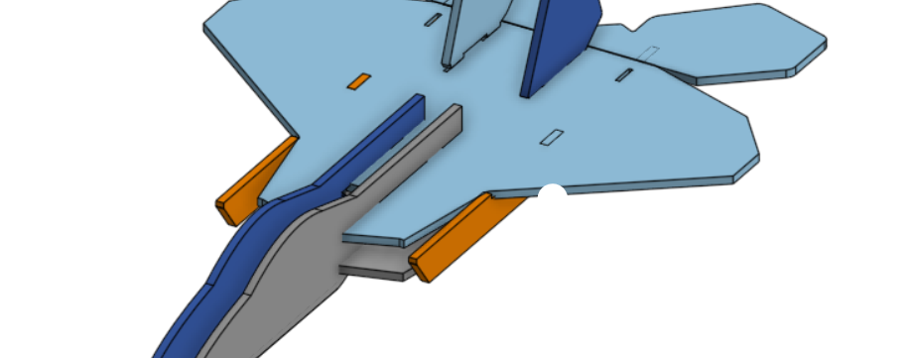
After Assembly

Slide 8

Building with Thin Cardboard Sheet

Slide 9
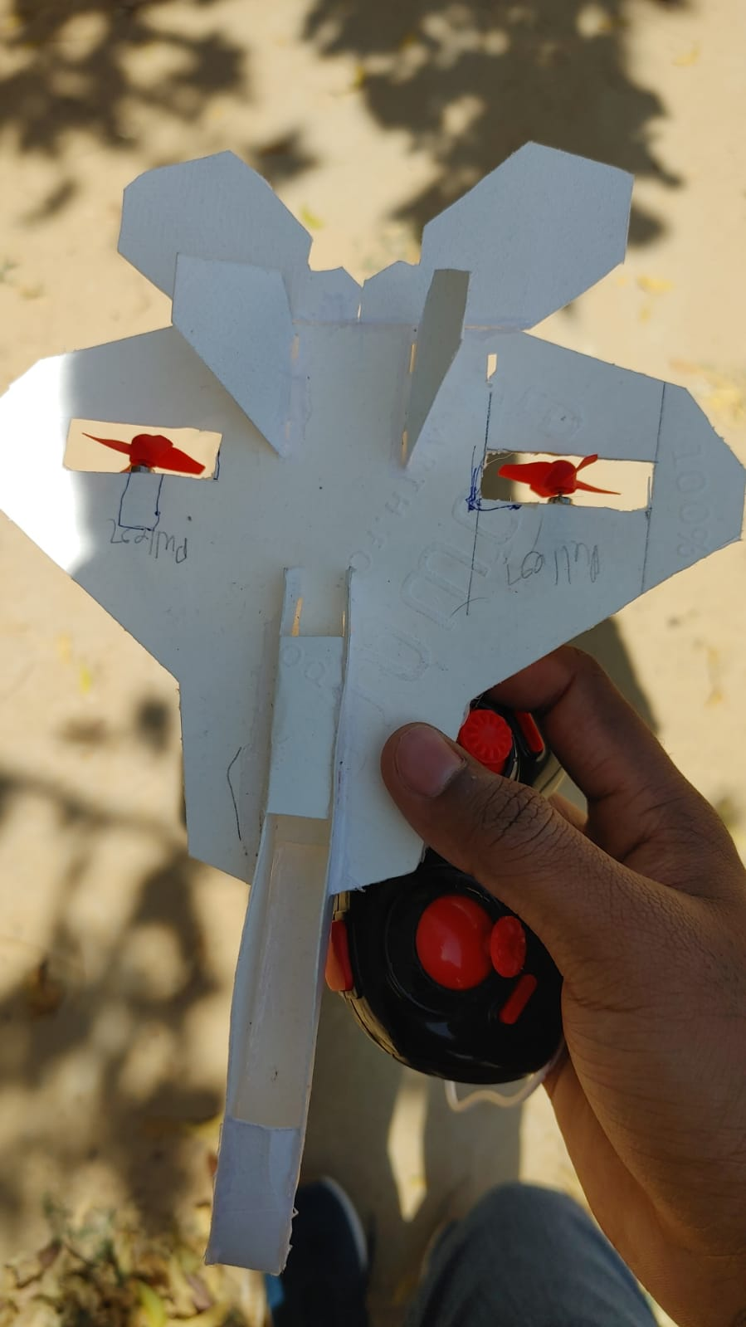
Plane With Motors/Engines.

Slide 10
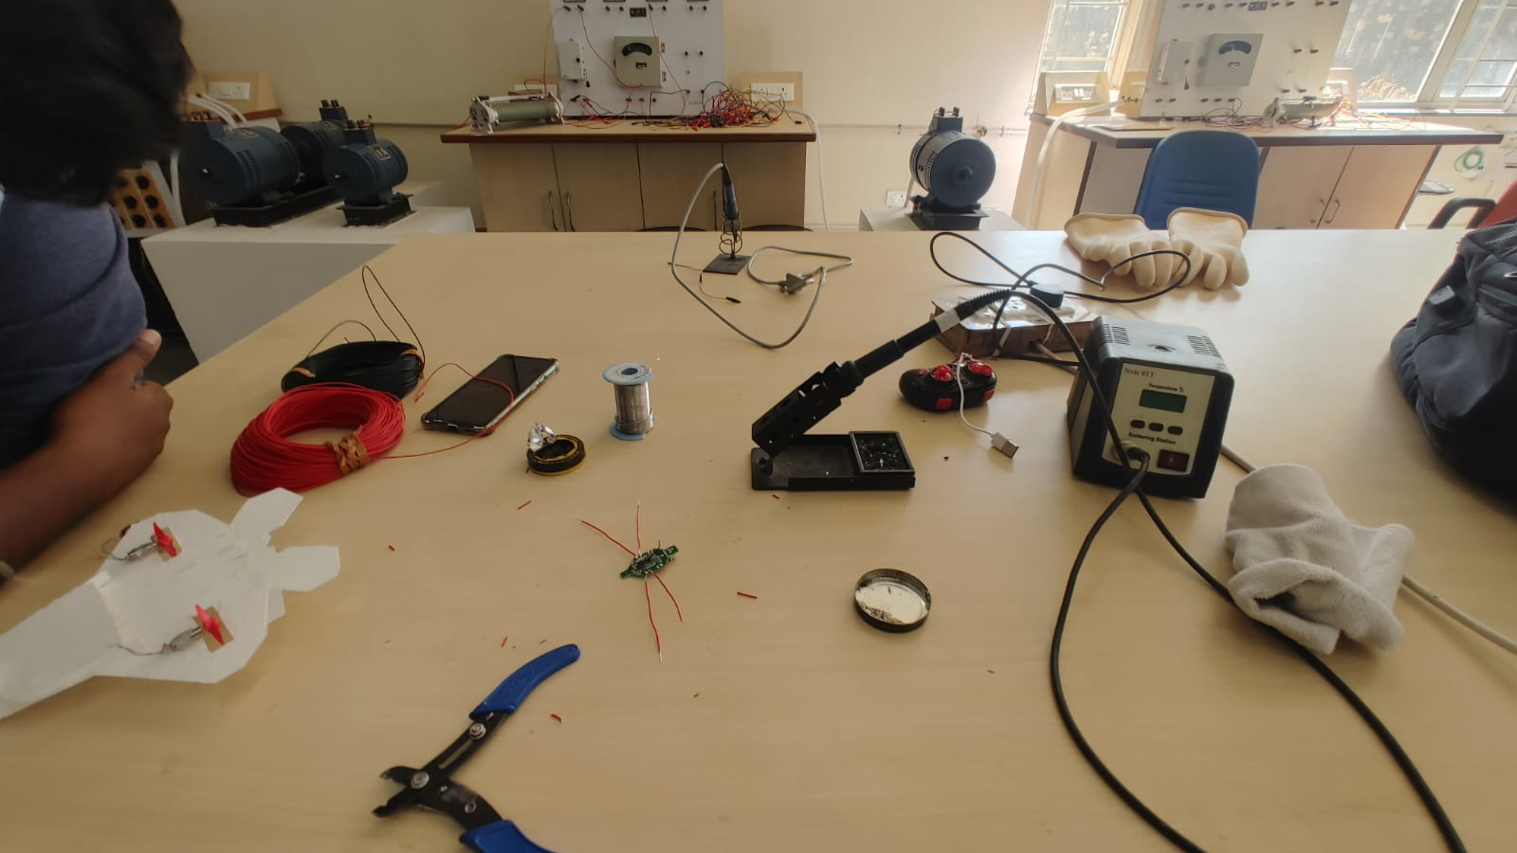
Workshop

Slide 11
Summary
Built a prototype of f22 fighter jet with some modifications using software (Onshape),Real plan made with thin cardboard sheet , and electronics components.

Slide 12
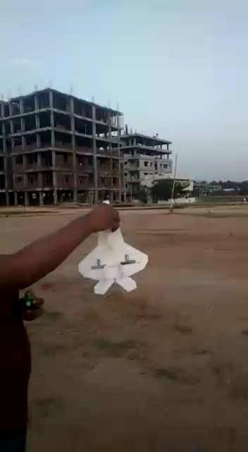
Video of Aircraft While Flying.

Slide 13


Thank You
Godala Sukumar Reddy
godalareddy@jklu.edu.in

